Slide 1
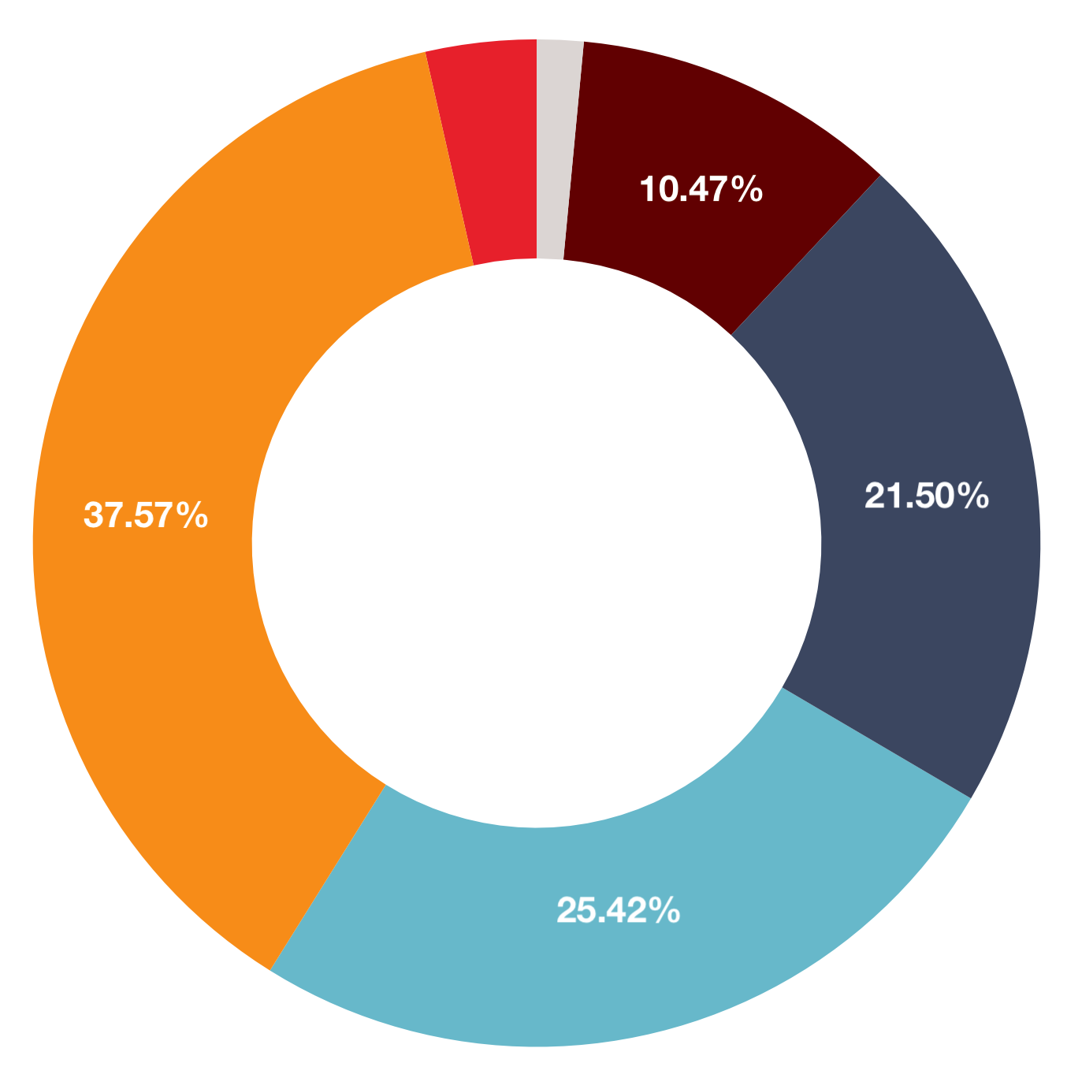
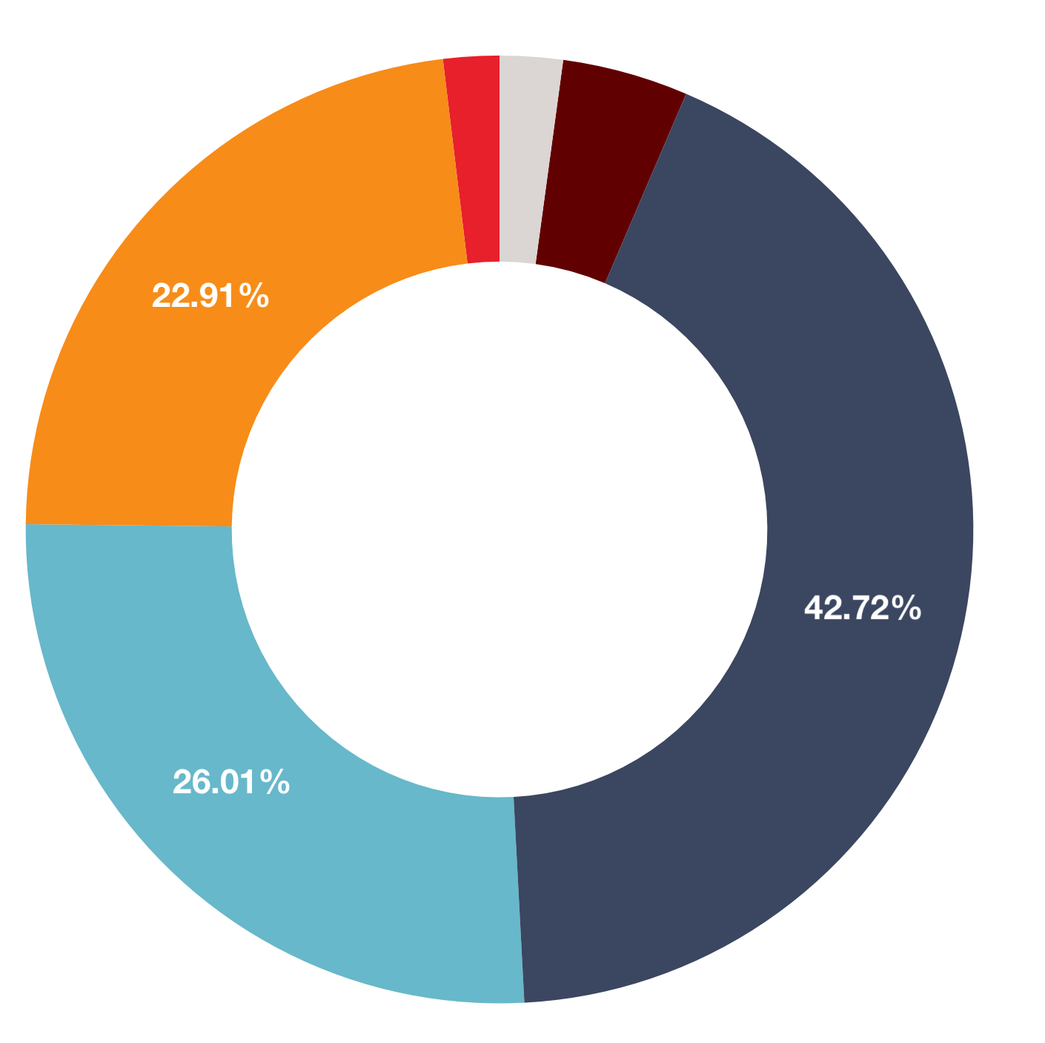
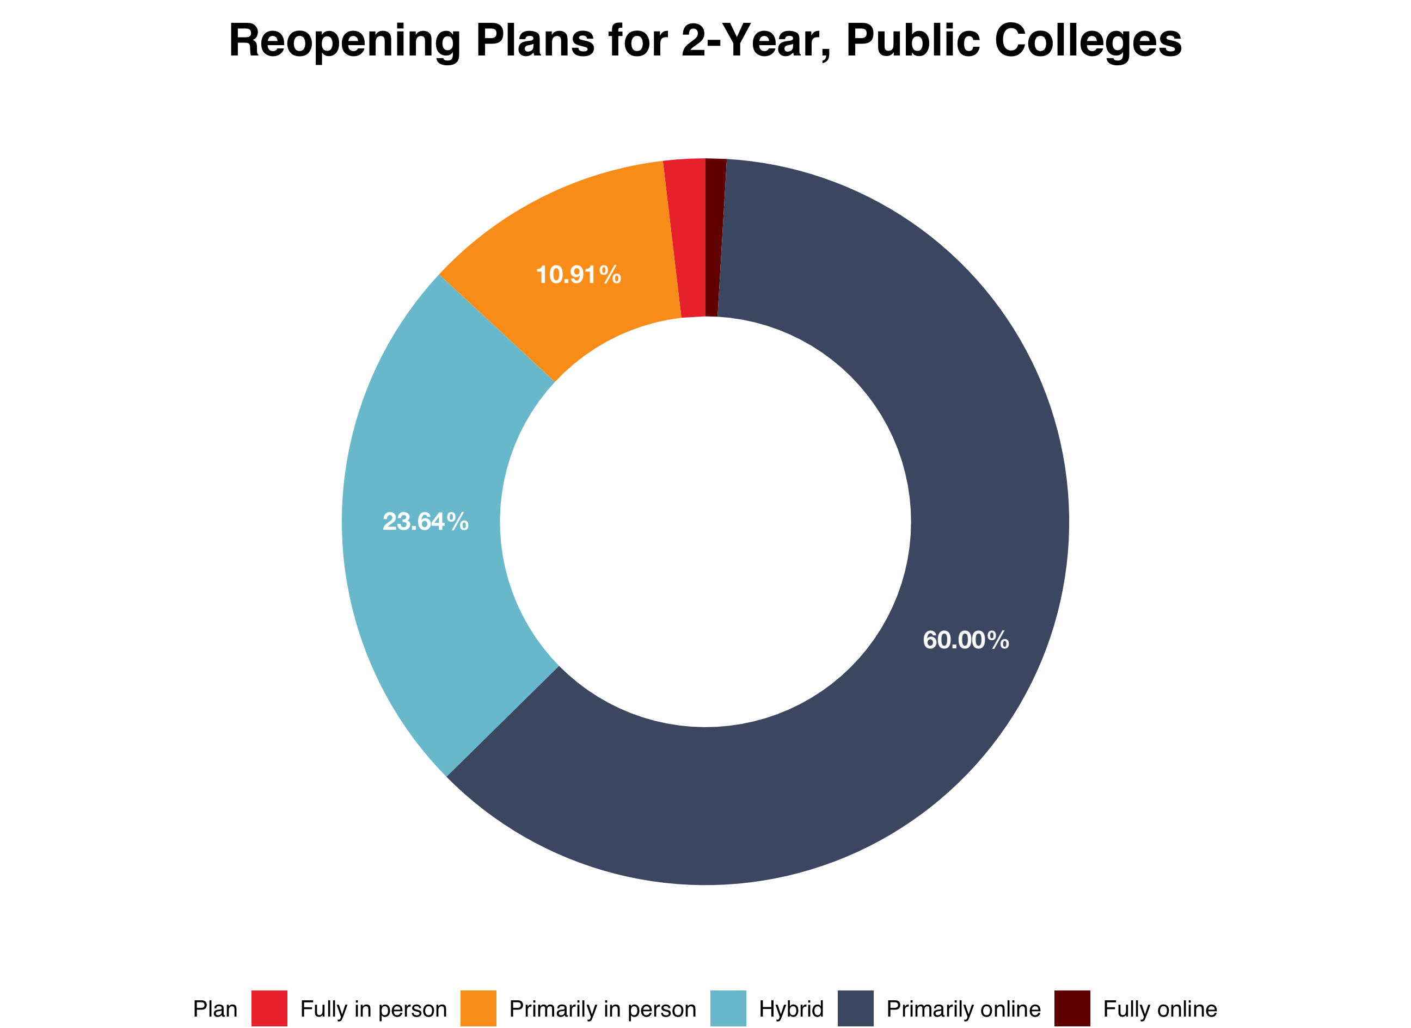
Reopening Plans by College Type
a) 4-Year, Private Nonprofit
b) 2-Year, Public
c) 4-Year, Public

